Slide 1

University of Central Florida COP 3330 Object Oriented Programming

Slide 2
Agenda
Expressions, Statements, and Blocks

Slide 3
Expressions

Slide 4
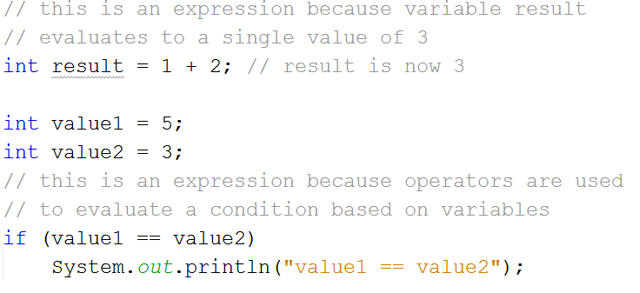
Expressions
An expression comprises variables, operators, and method invocations
Constructed according to the syntax of the language, that evaluates to a single value
int result = 1 + 2; // result is now 3
if (value1 == value2)
System.out.println("value1 == value2");

Slide 5
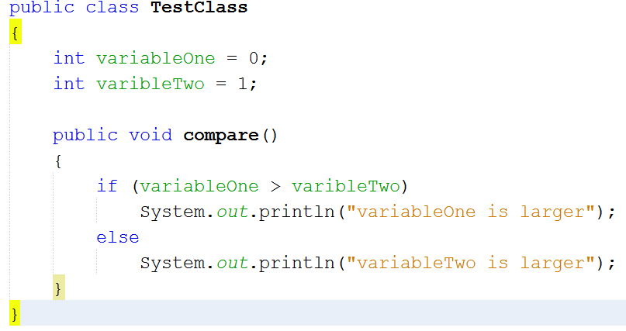
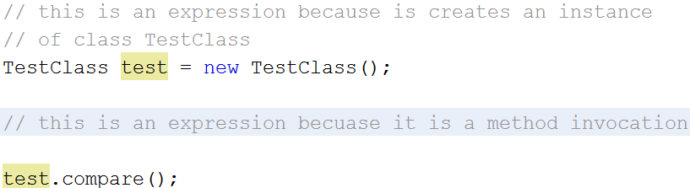
Expressions

Slide 6

Expressions
The data type of the return value is relative to the elements in the expression
Compound expressions can be created from various smaller expressions
The data types must match throughout the expression
int value = 1 * 2 * 3;

Slide 7
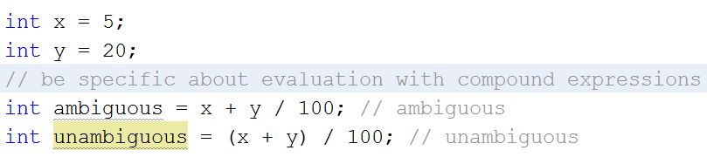
Expressions
Compound expressions can be created from various smaller expressions
Be specific regarding how an expression is evaluated otherwise precedence rules apply
int value = x + y / 100 // ambiguous
int value = (x + y) / 100 // unambiguous, recommended

Slide 8
Statements

Slide 9
Statements
An expression statement forms a complete unit of execution and terminating a semicolon (;)
// assignment statement
aValue = 8933.234;
// increment statement
aValue++;
// method invocation statement System.out.println("Hello World!");
// object creation statement
Bicycle myBike = new Bicycle();

Slide 10
Statements
A declaration statements declare a variable
// declaration statement
double aValue = 8933.234;
A control flow statements regulate the order in which statements get executed
if
if/else
if/else if/else
switch
for
while
do/while
break
continue
return

Slide 11
Block

Slide 12
Block
A block is a group of zero or more statements between balanced braces
A block can be used anywhere a single statement is allowed
boolean condition = true;
if (condition)
{ // begin block 1 System.out.println("Condition is true.");
} // end block one
else
{ // begin block 2
System.out.println("Condition is false.");
} // end block 2

